Slide 1
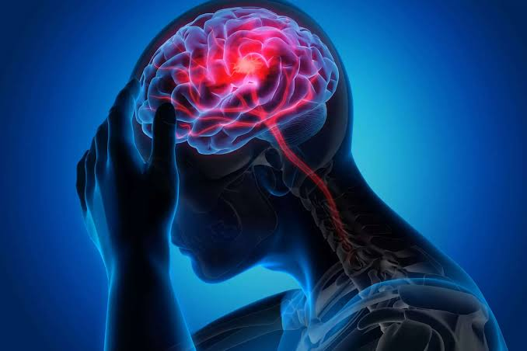
DATA ANALYSIS ON BRAINSTOKE
PREDICTIONS

Slide 2

Brain Stroke Prediction by Using Machine Learning A Mini project report submitted in The partial fulfilment of the requirements for the award of the degree of Bachelor of science {statistics} Submitted Shaikh Rehaan - (184) Shaikh Anis - (185) BaKShi Nizam - (186) Attar Jibraan - (190) Khan Raheesh - (206) Under the guidance of : Ms. Sarika Dangi

Slide 3
Bonafide Certificate
This is to certify that the project entitled “Brain Stroke Prediction by Using Machine Learning” is a bonafide record of the work done by Rehaan Shaikh(184),Anis Shaikh(185), Nizam Bakshi(186), Jibraan Attar(190),Raheesh Khan(206)under the supervision and guidance of Sarika ma’am & Umrani ma’am, Associate Professor in partial fulfilment of the requirements for the award of the degree of Bachelor of science in statistics from Modern College of Arts, Science and Commerce, Ganeshkhind, Pune-16 for the year 2023.
Research supervisor/Guide Head of the Department
Ms. Sarika Dangi Mrs. Rajashree M Umarani

Slide 4
Declaration
We hereby declare that the project work entitled “Brain Stroke Prediction by Using Machine Learning” is an original work done by Rehaan Shaikh(184),Anis Shaikh(185), Nizam Bakshi(186), Jibraan Attar(190),Raheesh Khan(206) under the esteemed guidance of Umrani ma’am, associate HOD of statistics deapartment, Modern College of Arts, Science and Commerce,. This project work is submitted in partial fulfilment of the requirements for the award of the degree Bachelor of Science (Statistics). This entire project is done to the best of our knowledge and is not submitted to any university for the award of degree.
Shaikh Rehaan - (184)
Shaikh Anis - (185)
Bakshi Nizam - (186)
Attar Jibraan - (190)
Khan Raheesh - (206)

Slide 5
Abstract
Brain stroke prediction is an important area of research in healthcare, as strokes can have severe consequences, including disability and death. In recent years, machine learning algorithms have been increasingly used to predict the likelihood of a patient experiencing a stroke, based on various demographic, medical, and lifestyle factors. This paper presents a review of recent research on brain stroke prediction using machine learning, with a focus on the use of Python programming language. The paper discusses the different machine learning algorithms that have been used for stroke prediction, including logistic regression, decision trees, and neural networks. It also discusses the datasets that have been used for training and testing these models, and the performance metrics that have been used to evaluate their accuracy. The paper concludes with a discussion of the challenges and opportunities for future research in this area, including the need for larger and more diverse datasets, and the potential for combining machine learning with other types of medical data analysis, such as imaging and genomics.

Slide 6
index
ACKNOWLEDGMENT :
INTRODUCTION :
KEYWORDS :
DATA COLLECTION :
MOTIVATION :
PROBLEMS FACED IN PROCESSING OF DATA & MODEL BUILDING :
FACTOR AFFECTING BRAINSTOKE :
GRAPHS FOR RAW DATA :
GRAPHS FOR FILTERED DATA :
CONCLUSION :

Slide 7
Acknowledgment
We would like to express our heartfelt gratitude to Umrani Ma'am and Sarika Ma'am for their invaluable guidance and support throughout this project which has been pivotal in shaping this project. Their expertise in the field of statistics and programming has been instrumental in helping us complete this project successfully.
We are also thankful for their patience and encouragement during the challenging times of this project. Their insightful feedback and constructive criticism have helped us refine our skills and produce a high-quality project.
Additionally, we would like to acknowledge the contributions of our classmates who provided helpful suggestions and feedback during the project's development.
Group ‘A’
T.Y.B.Sc. Statistics.

Slide 8
introduction
A stroke, also known as a brain attack, is a medical emergency that occurs when blood supply to a part of the brain is interrupted or reduced, causing brain cells to die. Strokes can be caused by a blockage in an artery that supplies blood to the brain (ischemic stroke) or by bleeding in the brain (hemorrhagic stroke).The symptoms of a stroke can include sudden weakness or numbness in the face, arm, or leg, especially on one side of the body; sudden confusion, trouble speaking or understanding speech; sudden difficulty seeing in one or both eyes; sudden trouble walking, dizziness, loss of balance or coordination; and sudden severe headache with no known cause.Prompt medical attention is critical in the case of a stroke because early treatment can minimize brain damage and improve the chances of recovery. Treatment options for stroke may include medications, such as clot-busting drugs or blood thinners, or procedures such as surgery or endovascular therapy to remove a blood clot or repair a ruptured blood vessel. Rehabilitation and lifestyle changes, such as diet and exercise, may also be necessary to aid recovery and prevent future strokes.

Slide 9
KEYWORDS :- THE KEYWORDS THAT OCCUR FREQUENTLY IN OUR PROJECT ARE:-
Brainstroke
Machine learning
Power BI
Data analysis
Pre processing
Logistic regression
Correlation
Heatmap
Model building
Pipeline
Accuracy
Prediction

Slide 10
Data collection
“Stroke Prediction Using Machine Learning ”
The Electronic Health Record (EHR) controlled by McKinsey & Company was used as the dataset in our research which was a part of their healthcare hackathon. The dataset is easily accessible as a free dataset repository. The gathered data contained information of 29, 072 patients having 12 common attributes. Out of the 12 attributes, 11 of them are input features including age, gender, marital status, patient identifier, work type, residence type (urban/rural), binary attribute heart disease condition, body mass index, smoking status of patient, glucose level and binary attribute hypertension indicating a patient is suffering from hypertension or not. The 12th attribute is the binary output attribute indicating a patient is suffered stroke or not.

Slide 11
motivation:
"As students of statistics we were motivated by a desire to contribute to the prevention and treatment of a critical public health issue. Brain stroke is one of the leading causes of death and disability worldwide, and yet there is still much we do not know about its causes, risk factors, and prevention. By using statistical models and machine learning algorithms to analyze large datasets of patient information, I hope to gain new insights into the factors that contribute to stroke risk, and to develop more accurate and personalized tools for predicting stroke risk. The importance of this project cannot be overstated. Stroke is a devastating disease that can have lifelong consequences for patients and their families. By predicting stroke risk early and accurately, we can identify patients who may be at higher risk and intervene with targeted prevention strategies, such as lifestyle changes or medical treatments. Additionally, by better understanding the underlying risk factors for stroke, we may be able to develop new interventions or therapies to reduce the overall burden of stroke on society. We believe that this project has the potential to do just that, by advancing our understanding of stroke risk and prevention and by contributing to the development of more effective and personalized health interventions.

Slide 12
Problems faced in processing of data and model building:
Original Dataset:
In the original dataset there were a lot of regressors with categorical and multi-categorical data. By using label encoding and one hot encoding we converted the object type data into binary form. We also scaled some regressors with large values by using min-max scaler so that the model does not get affected by values with huge magnitudes and would be able to correctly predict the response variable(brainstroke).After building a logistic regression model and predicting, we observed that the model was only predicting "0" values for brainstroke because it didn't get enough samples of people who had brainstroke("1") as the people who suffered with brainstroke is very less in comparison to people who didn't get brainstroke. So we had to use a pipeline to do under sampling of "0" type data and over sampling of "1" type data in order to create sample of data which is of large enough size so that the model gets trained well.Then we were finally able to correctly predict the values of brainstroke with 83% accuracy and 21% Precision.

Slide 13
Factors affecting brainstroke: (A theoretical background)
BMI :
BMI stands for Body Mass Index, and it is a measurement of a person's body fat based on their weight and height. It is commonly used to assess whether someone is underweight, normal weight, overweight, or obese.
Avg Glucose Level :
Average glucose level refers to the amount of glucose present in a person's blood over a certain period of time, usually measured in milligrams per deciliter (mg/dL) or millimoles per liter (mmol/L). It is an important indicator of a person's blood sugar control and can be used to diagnose and monitor diabetes.
Heart Disease :
Heart disease refers to a range of conditions that affect the heart, including coronary artery disease, heart failure, and arrhythmias. It is a leading cause of death worldwide and can be caused by factors such as high blood pressure, high cholesterol, and smoking.
Brain stroke:
A stroke occurs when blood flow to a part of the brain is interrupted, either by a clot (ischemic stroke) or a bleed (hemorrhagic stroke). It can lead to brain damage, disability, or even death, and prompt medical attention is crucial to minimize its effects.
Hypertension:
Hypertension, also known as high blood pressure, is a condition where the force of blood against the walls of arteries is consistently elevated. It is a major risk factor for heart disease, stroke, and other health problems, and can often be managed through lifestyle changes and medication.

Slide 14
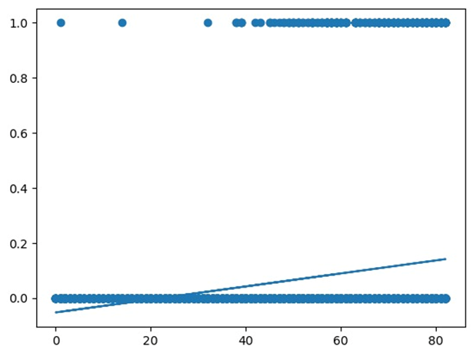
Interpretation : In the above graph, a regression line is formed, we can conclude that in ages 0-18, the population having stroke is very less in comparison to age group 18-82. Therefore, Due to the large difference of proportion of strokes between these 2 age groups, we decided to remove the population which falls under age group (18-80) so that it doesn't greatly affect our model.
GRAPHS FOR RAW DATA :

Slide 15
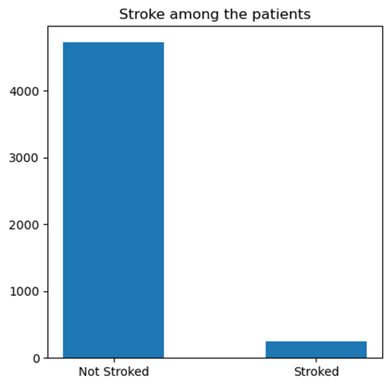
0 0.950211 1 0.049789 Name: stroke, dtype: float64 Interpretation: As you can see that the 95% of the patient doesn't have stroke while 5% have stroke

Slide 16
Fitment of logistic regression
As linear regression was not giving the possibility of having stoke or not , as the response variable is in binary type so we need to proceed with logistic regression as most of the raw data was in binary and float type.
We have eliminated the data of age 0-17 as the stoke percent was 0.02%,and it was predicting the false positive(0).Hence we have eliminated the data of age 0-17 and we have proceeded with the data of age 18-80 for logistic regression and name the data as filtered data.

Slide 17
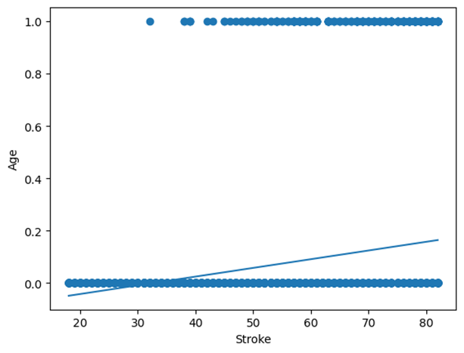
Graphs for filtered data :
Interpretation :
From this graph we can conclude that, as age increases the population having brainstroke also increases. Therefore we can say that Age and Brain stroke are positively correlated

Slide 18

0 0.940837
1 0.059163
Name: stroke, dtype: float64
Interpretation : As you can see that the 95% of the patient doesn't have stroke while 6% have stroke

Slide 19
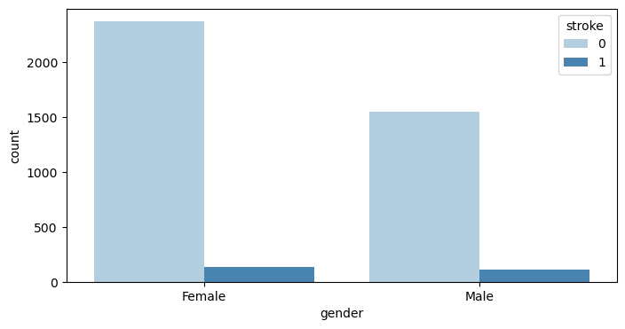
Interpretation :
From the above graph we can say that female gender has less stroke percentage (5.5% ) in comparison to male
(6.5%)

Slide 20
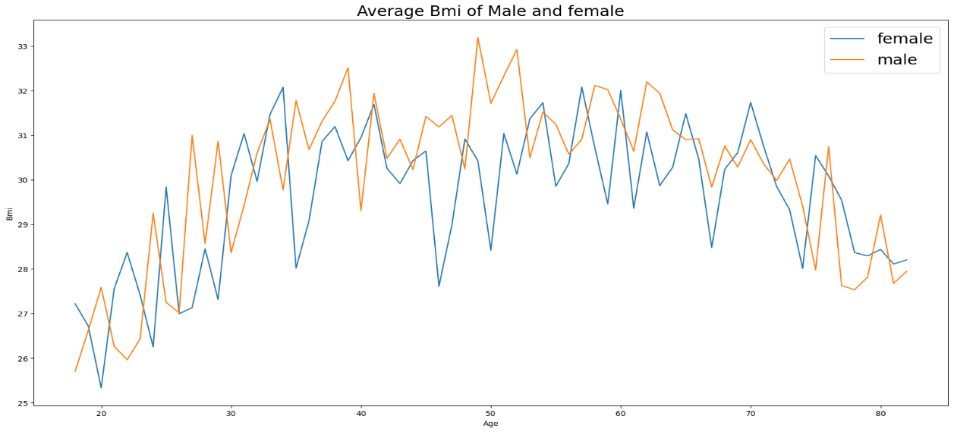
Interpretation:
From above graph we can conclude that bmi increases from age 20-30 then the bmi from age 30-75 ranges from 27.5-33 and the gradually decreases from age 75-above.

Slide 21
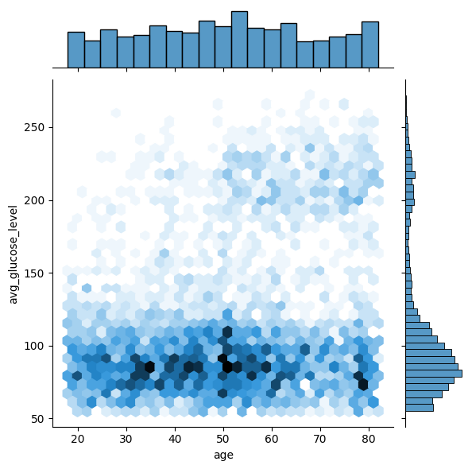
JOINT PLOT OF Age vs avg glucose level
Interpretation:
From above we can conclude that the age from 30-60 have average glucose level 50-100

Slide 22
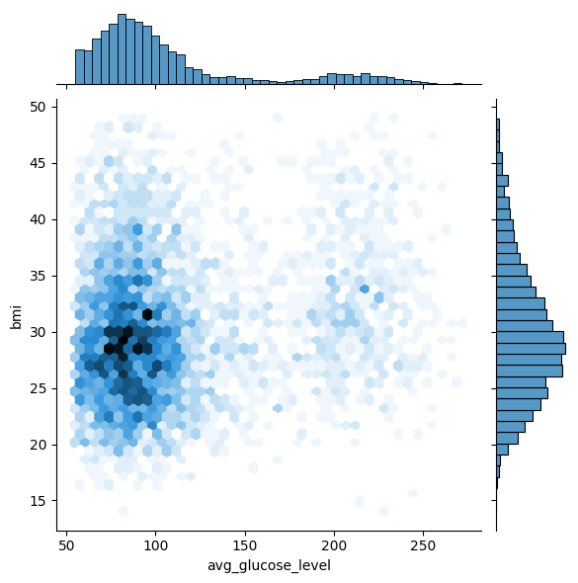
Jointplot of Avg glucose level vs bmi
Interpretation:
we can conclude that bmi 23-35 are having average glucose level 55-100.

Slide 23
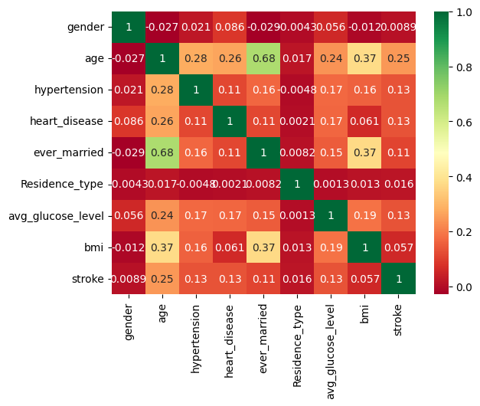
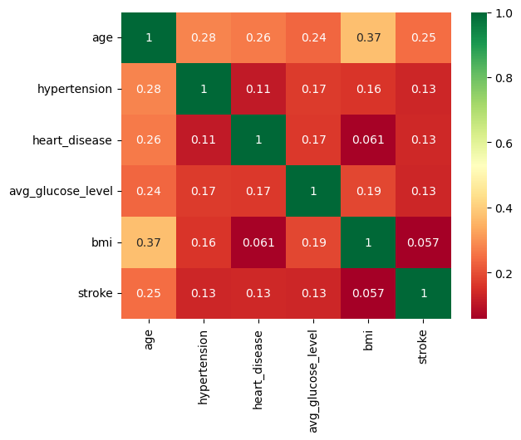
Heatmap for rAw data :
HEATMAP FOR FILTERED DATA :
INTERPRETATION:
After comparing these two heatmaps we can say that ,the correlation between variable is better in the heatmap for filtered data.

Slide 24
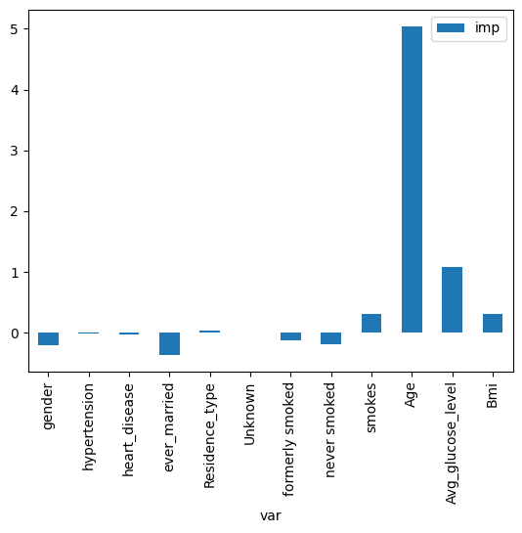
INTERPRETATION:
The above graph shows the importance of variables and how each variable affects brainstroke. From the above graph we can say that, "age" is the most important regressor followed by "avg glucose level" and "BMI" and it shows positive correlation with stroke.
While "formerly smoked" and "never smoked" are negatively correlated with brain stroke That means as the no of people who never smoked increases, people affected with brain stroke decreases

Slide 25
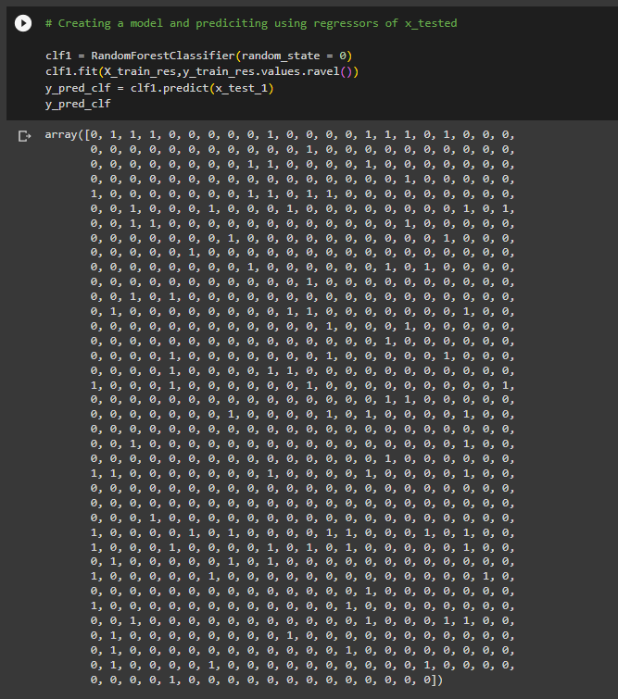
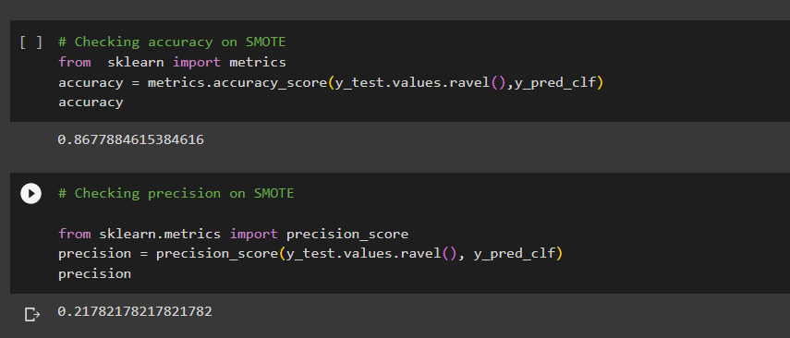
CONCLUSION:==>
Predcition of brainstroke :We created a logistic regression model and also used a pipeline in order to over sample and under sample the data. We were able to successfully predict the values of brainstroke prediction upto 87% accuracy.
OUTPUT:
Accuracy = 86.77 %
Precision = 21.78 %

Slide 26
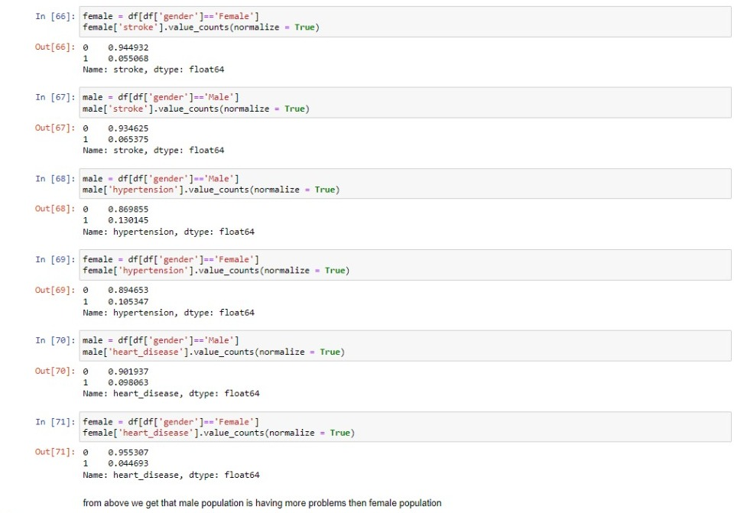
From above we get that male population is having more problems them female population.

Slide 27
THANK – YOU…

